Slide 1
Positive Parent Partnerships
17th September 2019

Slide 2
Children have two main educators in their lives: their parents and their teachers. Both have crucial roles to play and the impact of learning is greater if we work together with shared aims. We strive to make our school a welcoming place for parents with an ethos based on mutual trust and respect.
Parent involvement in our school can be divided into 2 broad strands:
Parental involvement in the life of the school
Parental support for the individual child at home and at school

Slide 3
Positive Behaviour

Slide 4
What do We Expect?

Slide 5
What are the Rewards?*
‘Green all week/term/year’ rewards
Raffle tickets
Extra playtimes
Steeton Superstar
Certificates home
Head teacher's award
*it is an expectation that all pupils conduct themselves well throughout the day, including lunchtimes

Slide 6
red
amber
warning
green

Slide 7
What are the Consequences?
All children start each new day on green
Children remain green for following Steeton’s 4 rules
Rewards available for green behaviours

Slide 8
What are the Consequences?
A warning simply allows a child a visual reminder to follow the rules to avoid moving to amber

Slide 9
What are the Consequences?
Children move to amber for repeatedly not following Steeton rules

Slide 10
What are the Consequences?
A ‘red letter’ is sent home
A playtime detention is issued. During the detention, children work on a ‘reflection task’ which allows them to contemplate their actions and identify any repairs that may be necessary

Slide 11
How can You Help?
Give encouragement and show appreciation of your child’s school efforts
Talk about Steeton’s school rules at home
Model positive behaviour
Set boundaries at home to develop resilience
Check Ping, Steeton’s website and Twitter feed for school news
Keep in touch: email, phone, face-to-face
Attend parents’ drop-ins, parents’ evenings and information sessions

Slide 13
Attendance Statistics for Parents
Every Minute Counts
Daily lateness | Equates to
5 minutes late each day | 3 days lost each school year
10 minutes late each day | 6.5 days lost each school year
15 minutes late each day | 10 days lost each school year
20 minutes late each day | 13 days lost each school year
30 minutes late each day | 19 days lost each school year
Every Day Counts
Attendance | How much school is missed each week/fortnight | How much school is missed each year | Approximate absence over 5 school years
95% | Half a day | 2 weeks | Quarter of a school year
90% | Half a day weekly | 4 weeks | Half a school year
85% | One and a half days fortnightly | 6 weeks | Three quarters of a school year
80% | One day weekly | 8 weeks | One school year
75% | Two and a half days fortnightly | 10 weeks | One and a quarter school years
70% | One and a half days weekly | 12 weeks | One and a half school years
65% | Three and a half days fortnightly | 14 weeks | One and three quarter school years

Slide 14
Parent Pay

Slide 15
Parent Pay

Slide 16
Pupil Premium
The pupil premium is a sum of money given to schools each year by the Government to improve the attainment of disadvantaged children.
Primary schools are given a pupil premium for:
Children in Reception to Year 6 who are, or have ever been, entitled to free school meals based on their family income: £1320 per pupil, per school year
Children in care: £2300 per pupil, per school year
Children previously in care who have been adopted, or who have a special guardianship order, a child arrangements order or a residence order: £2300 per pupil, per school year
Children recorded as being from service families: £300 per pupil, per school year

Slide 17
Pupil Premium
How to claim your child’s pupil premium
Children qualify for Free School Meals – and accordingly pupil premium – if you receive any of the following benefits:
Universal credit (provided you have a net income of £7400 or less)
Income support
Income-based jobseekers’ allowance
Income-related employment and support allowance
Support under Part IV of the Immigration and Asylum Act 1999
The guaranteed element of state pension credit
Child tax credit, provided that you are not also entitled to working tax credit and have an annual gross income of £16,190 or less
These benefits have now been rolled into a single benefit, called Universal Credit.
All children in Reception to Year 2 receive free school meals automatically paid by the Government. However it is important you apply for Pupil Premium if you are eligible – as we do not automatically receive the payments.

Slide 18
School Uniform
.
PE kit:
School jumper or cardigan
Plain white t shirt
Shorts
Tracksuit bottoms
Black trainers (non scuff)

Slide 19
School Uniform
.
Please support us with:
Earrings
Jewellery
Stationery and toys
Hair and headwear

Slide 20
Uniform Exchange
What is it? The Uniform Exchange will be a series of ‘pop-up shops’ held after school in the hall offering good quality, clean, pre-owned school uniform.
Why? Too much uniform, often in good condition, is thrown away. This is a waste of decent clothing that can be used elsewhere.
Where does the stock come from? Initially, from Lost Property; unclaimed and unlabelled items which is usually dumped. Items in good condition will be washed and ironed. Later, parents can donate outgrown and unwanted school uniform. We’ll be in touch when we’re ready for donations.
What about Lost Property with names on? Lost Property will be checked regularly. Labelled items will stay in Lost Property. Unlabelled items will move to The Exchange if they are in good condition.

Slide 21
Uniform Exchange
Should I bother putting labels in my children’s clothes? Yes.
How much will things cost? Items are free, but there will be an opportunity to make donations if you want.
Who’s running The Uniform Exchange? Parent and Carer volunteers.
Who will benefit? Parents – Lost Property management will be much improved and it will be easier to find your child’s items. Families – For those on benefits or with low incomes The Exchange will hopefully ease some of the stress of buying new uniform. Children – They get to have their lost items back! School Environment – School will be less cluttered with lost items.

Slide 22
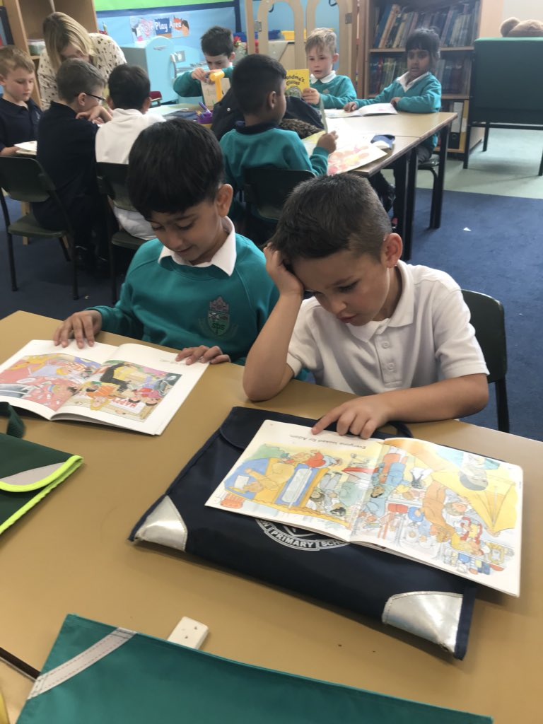
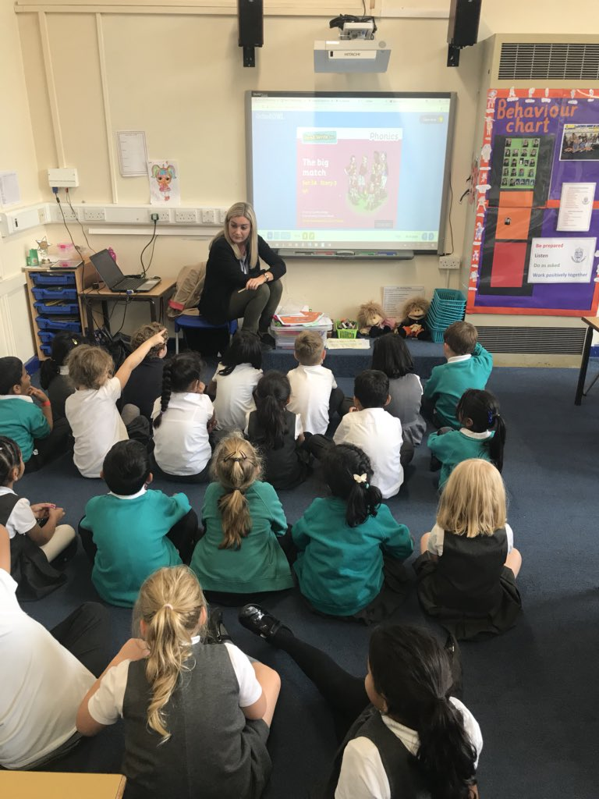
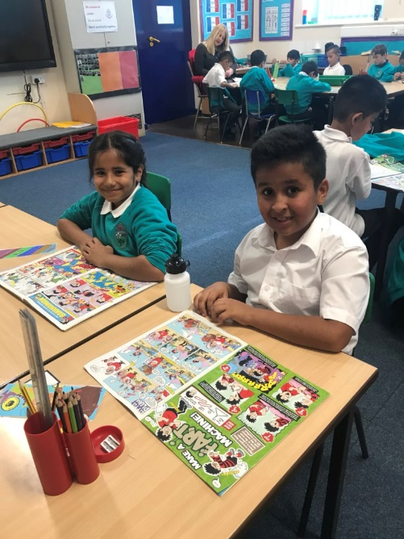
Reading at Steeton
Weekly library session
Home reading record
Volunteers

Slide 23
Parent Drop-In
Monday 21st October 2019
Pupil Progress Parent Drop in 3:30 -5:15pm
Monday 3rd February 2020
Pupil Progress Parent Drop in 3:30 -5:15pm

Slide 24
Parent Coffee Mornings

Slide 25
Friends of the School
We need you!

Slide 26
Inclusion and Welfare Officer
‘Captain OK’

Slide 27
Communication
Phone
Email
Ping
Meetings
Website
Staff

Slide 28
Parking and Safeguarding
Parking around School
Police and Wardens
Local Residents and after school events
School Gates

Slide 29
Thank you for your time!

